Slide 3
evidence
impaired
qualitative
quantitative

Slide 4
What do you know about alcohol and its effect on the body?
Record you answer in your notebook.

Slide 5
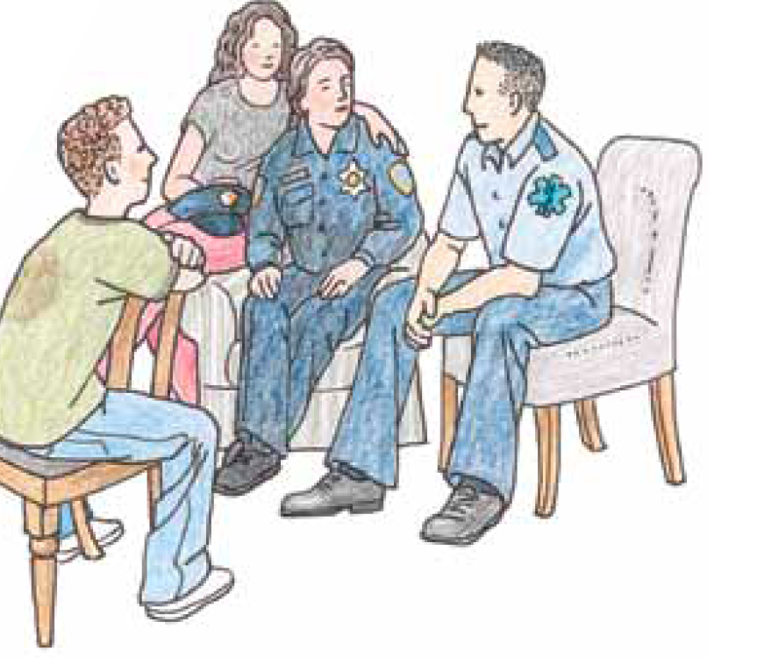
Read the introduction and look for key ideas

Slide 6
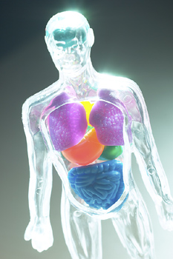
What human body systems are affected by alcohol?

Slide 7
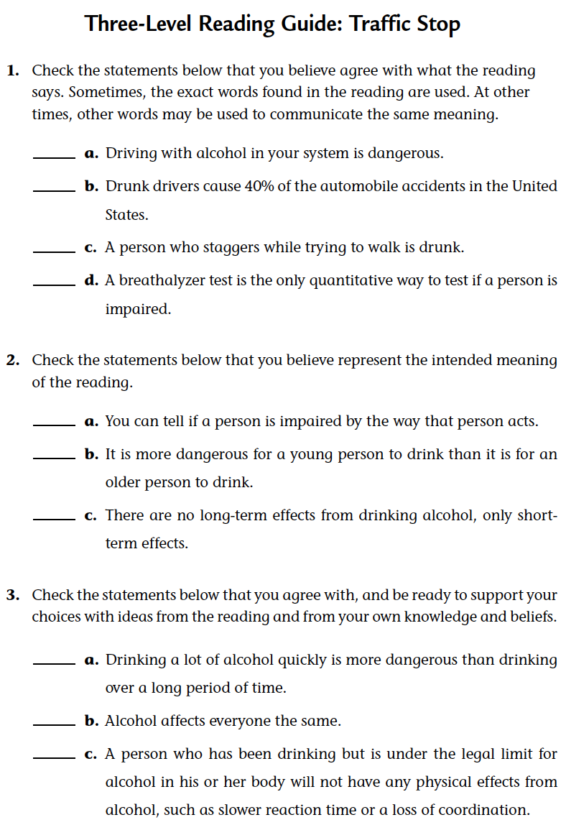
Read the role-play

Slide 8
Review
Impaired – a scientific description of a person’s physical state when affected by alcohol.

Slide 9
Effects of alcohol on the body
Look at the class list of the effects of alcohol on the body.
Which of the effects provide evidence that alcohol can be detected in the body?
Share your thoughts with the class.

Slide 10
Analysis question 1
Explain how alcohol affects each of the following body organs:
skin kidneys liver
heart brain stomach

Slide 11
Analysis question 2
What are some of the signs that a person is impaired by alcohol?

Slide 12
Analysis question 3
What qualitative evidence is there that a person may have been drinking?

Slide 13
Analysis question 4
What quantitative evidence is there that a person has been drinking?

Slide 14
Analysis question 5
How can a police officer determine if a person is impaired by alcohol?

Slide 15
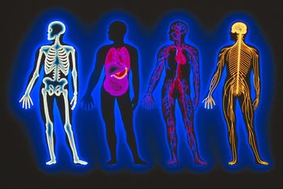
What human body systems are affected by alcohol?

Slide 16
Key Vocabulary definitions
Evidence - Observations or data to support a statement, hypothesis, or point of view.
Impaired - Diminished, damaged, or weakened in such a way that functioning becomes poor or ceases.

Slide 17
Key Vocabulary definitions
Qualitative - Information that is concerned with qualities, not numbers or quantities.
Quantitative - Information that is based on numerical measurements.

Slide 18
Teens and drinking
To find out more about teens and drinking, go to the Issues and Life Science page of the SEPUP website.
www.sepuplhs.org

